Slide 1
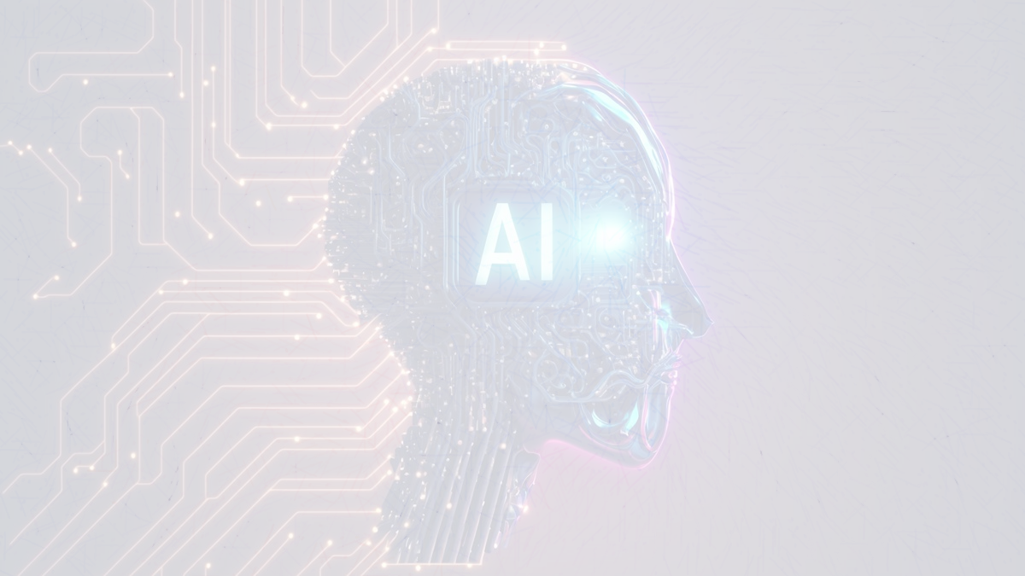
Artificial Intelligence
ENCT 305
BEI
IOE, Thapathali Campus
Semester V
Kiran Bagale

Slide 2
Course Objectives:
To build a strong foundation in Artificial Intelligence (AI), covering intelligent agents, search techniques, knowledge representation, machine and learning.
To equip students with both theoretical knowledge and practical skills to apply AI techniques in solving real-world problems.
To foster awareness of the ethical considerations associated with AI applications.

Slide 3
Course Contents
Introduction (4hrs.)
Problem Solving and Search (9hrs.)
Knowledge Representation and Probabilistic Reasoning (7hrs.)
Machine Learning Fundamentals (10hrs.)
Neural Networks and Deep Learning Algorithms (6hrs.)
AI Applications (7hrs.)
AI Ethics and Recent Trends (2hrs.)

Slide 4
References
Russell, S., Norvig, P. (2020). Artificial intelligence: A modern approach. Pearson.
Rich, E., Knight, K., Nair, S. B. (2009). Artificial intelligence. McGraw-Hill.
Bishop, C. M. (2006). Pattern recognition and machine learning. Springer.
Deisenroth, M. P., Faisal, A. A., Ong, C. S. (2020). Mathematics for
machine learning. Cambridge University Press.

Slide 5
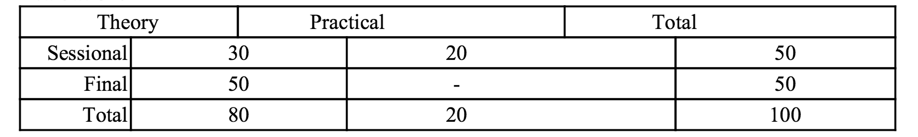
Evaluation
Theory
Attendance + Class performance: 20%
Assignments: 20%
Assesments:60%
Practical
Attendance : 30%
Class performance: 20%
Lab reports and Program assignments:60%

Slide 6
An Introduction to AI

Slide 7
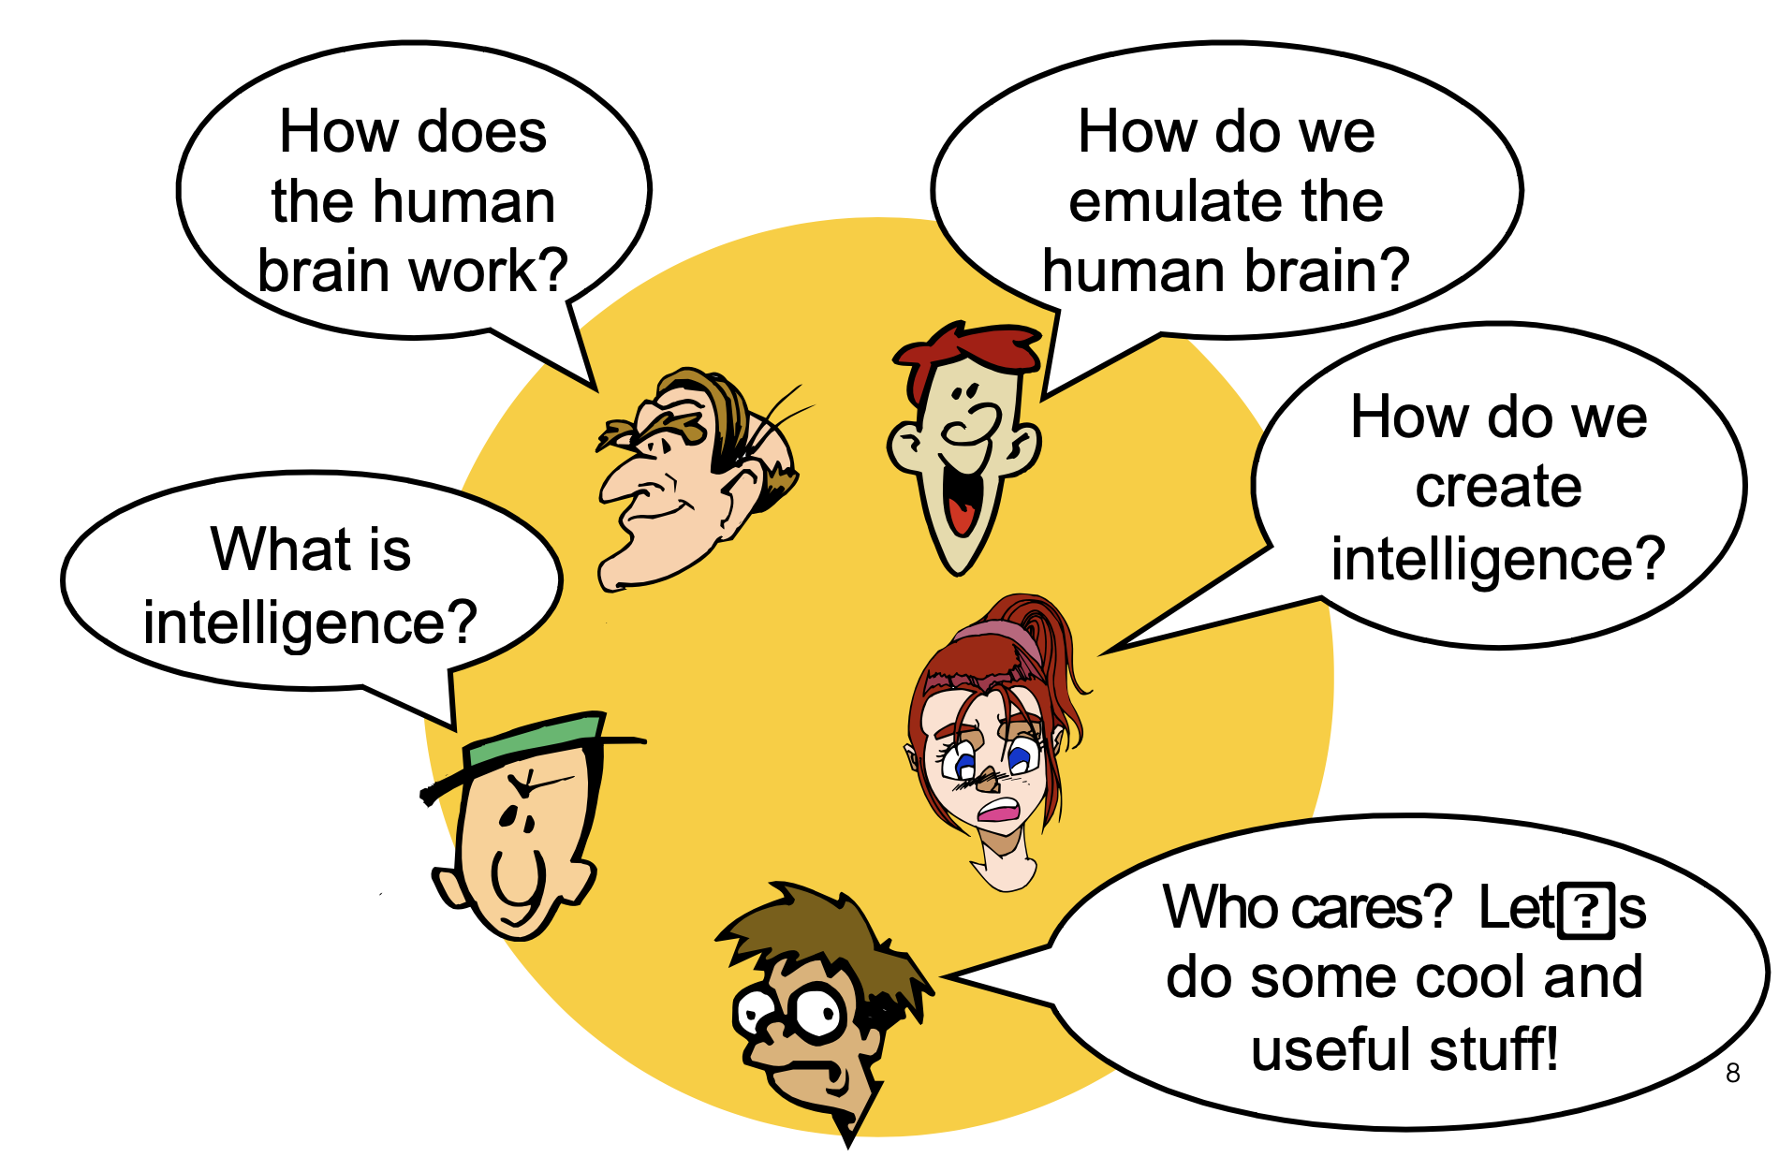
What is AI?

Slide 8
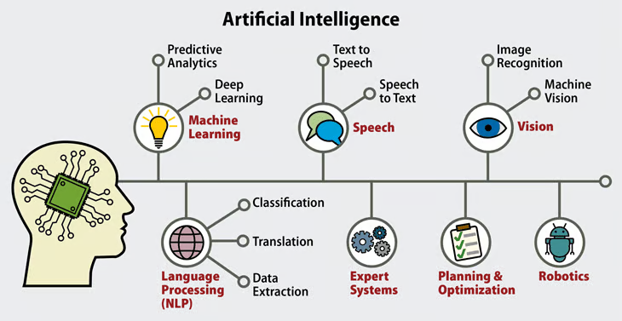

Slide 9
Meaning of the word: “intelligence”
1
(a) The capacity to acquire and apply knowledge.
(b) The faculty of thought and reason.
(c) Superior powers of mind. See Synonyms at mind.
2
An intelligent, incorporeal being, especially an angel.
3
Information; news. See Synonyms at news.
4
(a) Secret information, especially about an actual or potential enemy.
(b) An agency, staff, or office employed in gathering such information.
(c) Espionage agents, organizations, and activities considered as group
Source: The American Heritage® Dictionary of the English Language, Fourth Edition Copyright © 2000 by Houghton Mifflin Company. Published by Houghton Mifflin Company. All rights reserved.

Slide 10
Meaning of the word: “intelligence”
the ability to learn, understand, and make judgments or have opinions that are based on reason:
an intelligence test
a child of high/average/low intelligence
It's the intelligence of her writing that impresses me.
Source: Cambridge Dictionary
1: the ability to comprehend; to understand and profit from experience [ant: stupidity]
2: a unit responsible for gathering and interpreting intelligence
3: secret information about an enemy (or potential enemy); "we sent out planes
to gather intelligence on their radar coverage"
Source: WordNet ® 1.6, © 1997 Princeton University

Slide 11
What Behaviors are Intelligent?
Everyday tasks: recognize a friend, recognize who is calling, translate from one language to another, interpret a photograph, talk, cook a dinner
Formal tasks: prove a logic theorem, geometry, calculus, play chess, checkers, or Go
Expert tasks: engineering design, medical designers, financial analysis

Slide 12
Artificial Intelligence
Based on the above, `artificial intelligence' is about the science and engineering necessary to create artifacts that can
  acquire knowledge, i.e., can learn and extract knowledge; and
  reason with knowledge (leading to doing tasks such as planning, explaining, diagnosing, acting rationally, etc.),

Slide 13
Formal Definitions
Barr and Feigenbaum
“Artificial Intelligence is the part of computer science concerned with designing intelligence computer systems, that is, systems that exhibit the characteristics we associate with intelligence in human behavior.”
Elaine Rich
“AI is the study of how to make computers do things at which, at the moment, people are better”

Slide 14
Different Types of Artificial Intelligence
Modeling exactly how humans actually think
  cognitive models of human reasoning
Modeling exactly how humans actually act
  models of human behavior (what they do, not how they think)
Modeling how ideal agents "should think"
  models of "rational" thought (formal logic)
  note: humans are often not rational!
Modeling how ideal agents "should act"
  rational actions but not necessarily formal rational reasoning
  i.e., more of a black-box/engineering approach
Modern Al focuses on the last definition
  We will also focus on this "engineering" approach
  success is judged by how well the agent perform
  modern methods are inspired by cognitive & neuroscience (how people think).

Slide 15
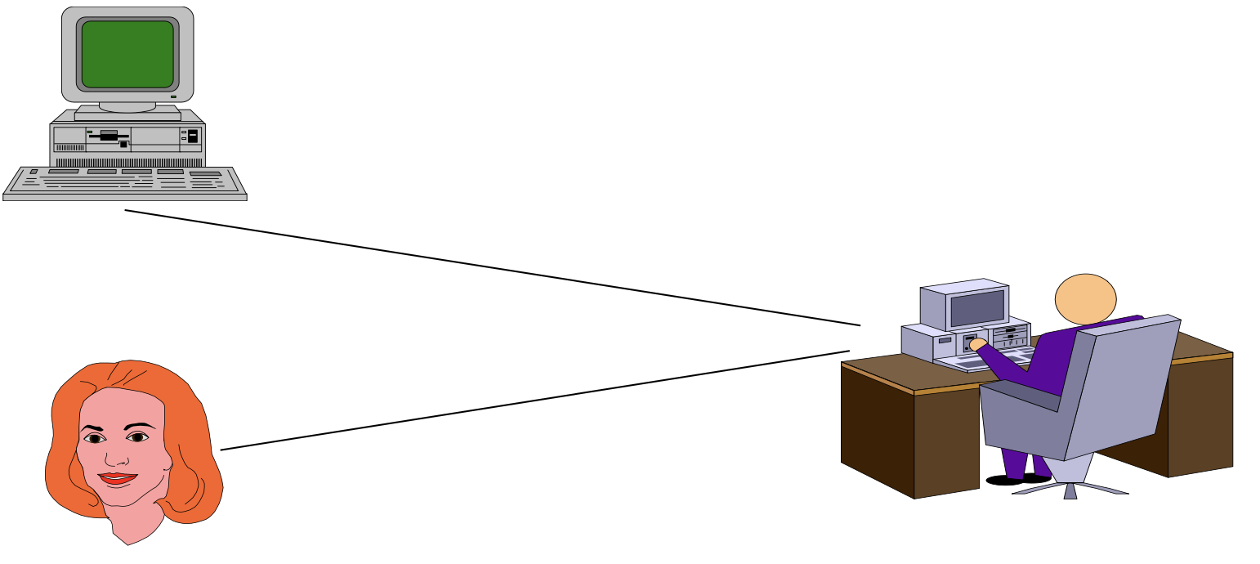
Acting humanly: Turing Test
Turing (1950) "Computing machinery and intelligence":
“Can machines think?”, ”Can machines behave intelligently?”
Operational test for intelligent behavior: the Imitation Game
The interrogator can communicate two with sources: one is human and the other is a machine
He must decide which is which
If he is wrong half the time, then the machine is intelligent

Slide 16
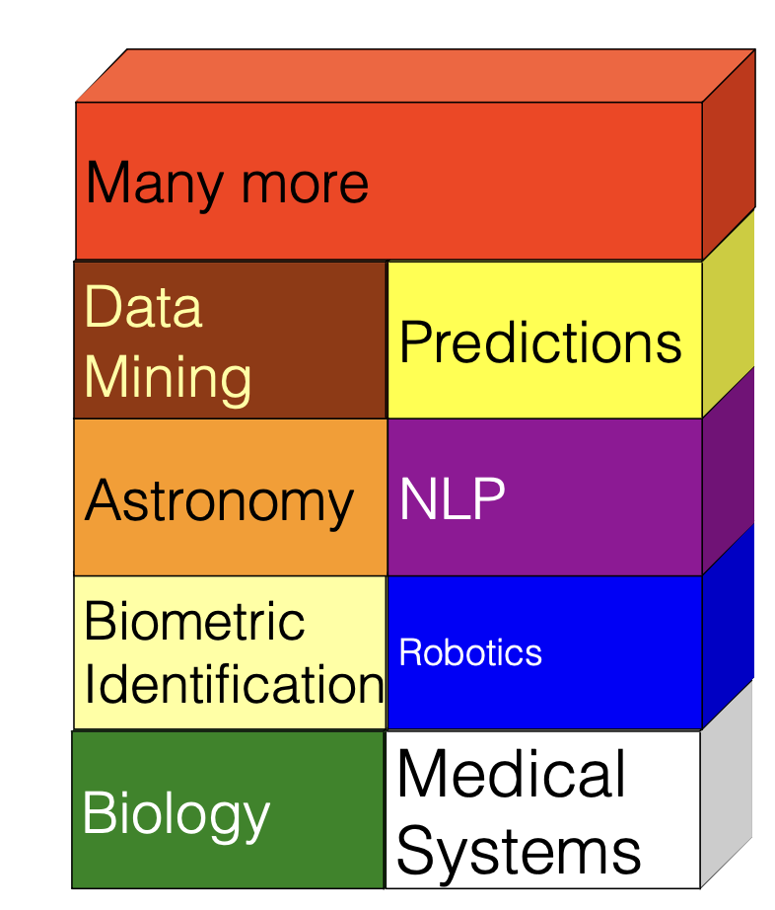
AI Today
Diagnose lymph- node diseases [Heckerman, 91]
Monitor space shuttle missions [Horvitz, 92]
Automatic vehicle control [Jochem et al., 96]
Large- scale scheduling [Smith et al., 96]
Classify astronomical objects [Goebel et al., 89]
Automatic design and configuration systems
First commercial speech understanding systems
Beat world's best players in chess, checkers, and backgammon.

Slide 17
History of AI
Early Foundations (Pre-1950)
  1921 - Czech playwright Karel Čapek introduced the word "robots" in his science fiction play "Rossum's Universal Robots" Tableau
  1929 - Japanese professor Makoto Nishimura built Gakutensoku, the first Japanese robot Tableau
  1935 - Alan Turing described an abstract computing machine with limitless memory and a scanner Encyclopedia Britannica
  1943 - Warren McCulloch and Walter Pitts designed the first artificial neurons Calls9
  1948 - Turing introduced many central AI concepts in his report "Intelligent Machinery"
Birth of AI (1950s)
  1950 - Alan Turing published "Computing Machinery and Intelligence," introducing the Turing test TechTarget
  1951 - Christopher Strachey wrote a checkers program and Dietrich Prinz wrote one for chess using the Ferranti Mark 1 machine TechTargetWikipedia
  1951 - Marvin Minsky and Dean Edmonds developed SNARC, the first artificial neural network using 3,000 vacuum tubes TechTarget
  1952 - Arthur Samuel developed Samuel Checkers-Playing Program, the world's first self-learning game program TechTarget
  1956 - The Dartmouth Conference, where John McCarthy coined the term "artificial intelligence" Coursera
  1958 - John McCarthy created LISP, the first programming language for AI research Tableau

Slide 18
History of AI
Early Development (1960s-1970s)
  1965 - Joseph Weizenbaum unveiled ELIZA, a precursor to modern chatbots Calls9
  1966-1972 - Shakey the robot, the first general-purpose mobile robot capable of reasoning about its own actions
  1970 - Marvin Minsky and Seymour Papert proposed the microworld approach for AI research Encyclopedia Britannica
  1972 - Dendral expert system showcased the potential of rule-based systems Calls9
  1972 - SHRDLU, written by Terry Winograd, could respond to commands in natural English Encyclopedia Britannica
  1974 - The first "AI Winter" began as U.S. and British governments stopped funding undirected AI research Wikipedia
AI Boom and Second Winter (1980s-1990s)
  1979 - The American Association of Artificial Intelligence (now AAAI) was founded Tableau
  1980 - XCON, the first commercial expert system, came to market Tableau
  1981 - Japan allocated $850 million to the Fifth Generation Computer project Tableau
  1986 - Neural networks resurged with the revolutionary concept of backpropagation Calls9
  1990s - Second AI winter as investors' enthusiasm waned
  1997 - IBM's Deep Blue defeated world chess champion Garry Kasparov
Modern AI Era (2000s-2010s)
  2011 - IBM Watson won Jeopardy!
  2012 - A convolutional neural network set new benchmarks in the ImageNet competition Calls9
  2014 - Ian Goodfellow formalized Generative Adversarial Networks (GANs) Calls9
  2015 - OpenAI was founded to channel AI advancements for humanity's benefit Calls9
  2016 - AlphaGo defeated world champion Go player Lee Sedol
  2016 - WaveNet introduced, capable of synthesizing human-like speech Calls9
  2016 - Sophia the humanoid robot was activated by Hansen Robotics Verloop
Recent Developments (2020s)
  November 30, 2022 - ChatGPT launched, gaining over 100 million users in two months and becoming the fastest-growing consumer software application in history Wikipedia
  2023 - Multiple companies launched competing large language models
  2024 - The European Parliament adopted the Artificial Intelligence Act

Slide 19
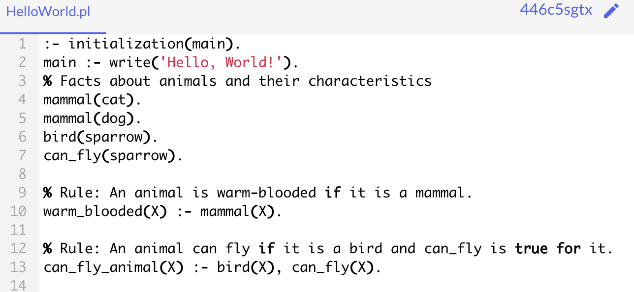
Prolog
First Prolog program: France, 1970
  Based on theorem proving research
  Major development at University of Edinburgh, 1975-79
  Adopted by the Japanese Fifth Generation Computing Project
Logic programming language:
  Programs composed of facts and rules
  Executes by applying first-order predicate calculus/unification to programs
  Interactive interpreter, compiler
  Tell the computer what is true and what needs to be done, rather than how to do

Slide 20
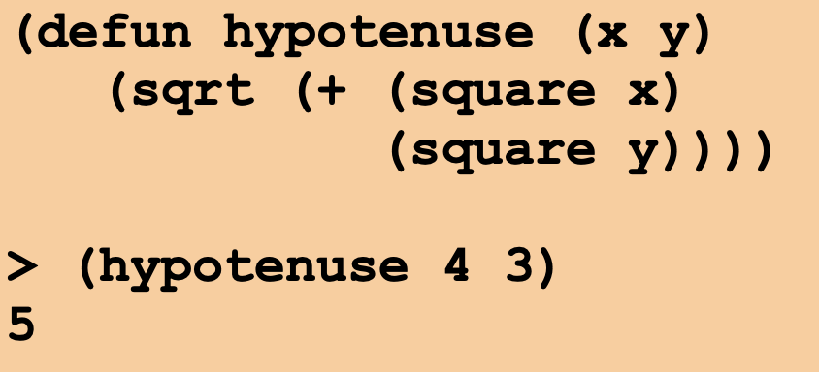
LISP
Proposed by McCarthy, late 1950s; contemporary of COBOL, FORTRAN
Functional programming language based on lambda calculus/recursive function theory
Intended as a language for symbolic rather than numeric computation
Interactive interpreter, compiler
Uses atoms, lists, functions.

Slide 21
Artificial Intelligence
Common sense reasoning
Reasoning under uncertain conditions
Learning from experience
Planning and executing complex tasks
Understanding and communicating in spoken/written language
Visual comprehension
Note: "easy for human" != "easy for machine".
  Chess is easy for computer, hard for human.
  Visual recognition of chess pieces is easy for human, hard for computer.
"Tasks that require knowledge of some domain"

Slide 22
Knowledge Definition
“The fact or condition of knowing something with familiarity gained through experience or association.” (Webster’s Dictionary, 1988)(Knowing
something via seeing, hearing, touching, feeling, and tasting.)
“The fact or condition of being aware of something” . (Ex. Sun is hot, balls are round, sky is blue,...)

Slide 23
Knowledge Storing
Natural language for people
  Symbols for computer: a number or character string that represents an object or idea (Internal representation of the knowledge).
  The core concepts: mapping from facts to an internal computer representation and also to a form that people can understand.

Slide 24
Knowledge Representation
Simple facts or complex relationships
Mathematical formulas or rules for natural language syntax
Associations between related concepts
Inheritance hierarchies between classes of objects
Knowledge is not a “one-size-fits-all” proposition.
Knowledge:
  Example: automated language translation (English <-----> Japanese)
  ”My name is hari bahadur."
  ”Madan bahadur is my friend."
  Must determine what this means using knowledge of human discourse in English word-by-word translation
  ---------------------> Then generate japanese form of that meaning

Slide 25
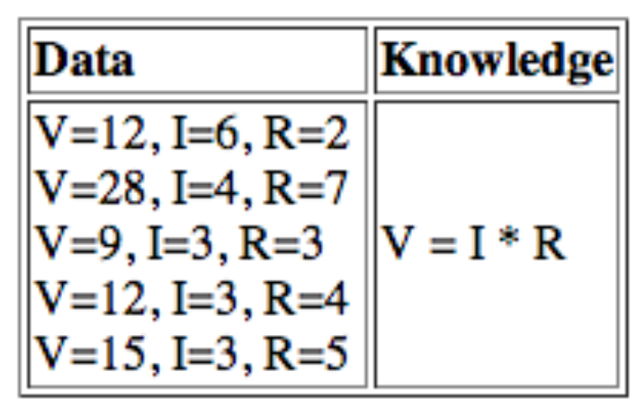
Knowledge
Note: knowledge != data.
Example: determining voltage from current and resistance
Knowledge is more compact and faster to manipulate.
Knowledge is more general (that is, may be applied to situations we have not
been programmed for).
Important feature of intelligence: creating knowledge from data.

Slide 26
Knowledge
"Heuristics for making good decisions when no algorithm exists for doing so"
That is, for many of the above problem, we must often make intelligent guesses due to:
  Lack of complete knowledge about how to solve problem.
  Lack of complete data about current situation.
  Lack of time to completely explore situation.
Example: walking across room.
  Do not have complete knowledge of physical laws associated with motion.
  Do not have complete knowledge of room (such as what might be behind objects).
  Do not have time to map out and compare all possible paths through room.

Slide 27
What is Learning?
Learning is one of those everyday terms which is broadly and vaguely used in the English language
  Learning is making useful changes in our minds
  Learning is constructing or modifying representations of what is being experienced
  Learning is the phenomenon of knowledge acquisition in the absence of explicit programming
Herbert Simon, 1983
Learning denotes changes in the system that are adaptive in the sense that they enable the system to do
the same task or tasks drawn from the same population more efficiently and more effectively next time.

Slide 28
What is Learning?
Learning involves 3 factors:
  Learning changes the learner: for machine learning the problem is determining the nature of these changes and how to best represent them
  Learning leads to generalization: performance must improve not only on the same task but on similar tasks
  Learning leads to improvements: machine learning must address the possibility that changes may degrade performance and find ways to prevent it.
Changes
Generalization
Improvement

Slide 29
What intelligent system can do?
Consider what might be involved in building a “intelligent” computer....
Can we build hardware as complex as the brain?
Must an Intelligent System be Foolproof?
Can Computers play Humans at Chess?
Can Computers Talk?
Can Computers Recognize Speech?
Can Computers understand Speech?
Can Computers “see”?
Can Computers plan and make decisions?

Slide 30
Academic Disciplines important to AI.
Philosophy Logic, methods of reasoning, mind as physical system, foundations of learning, language, rationality.
Mathematics Formal representation and proof, algorithms, computation, (un)decidability, (in)tractability, probability.
Economics utility, decision theory, rational economic agents
Neuroscience neurons as information processing units.
Psychology how do people behave, perceive, process Cognitive Science information, represent knowledge.
Computer building fast computers engineering
Control theory design systems that maximize an objective function over time
Linguistics knowledge representation, grammar

Slide 31
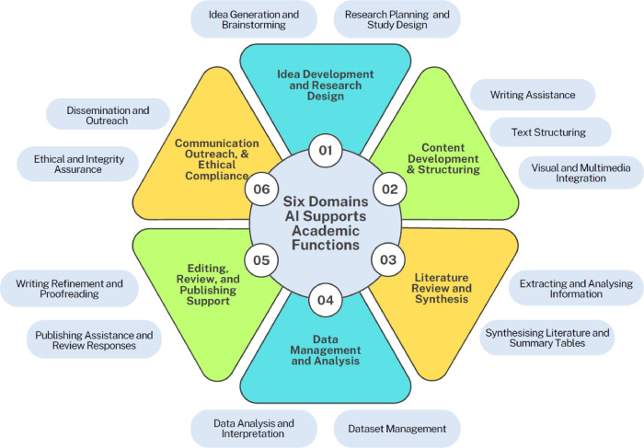

Slide 32
Intelligent Systems in Your Everyday Life
AI Applications

Slide 33
Thank You!!!

